Slide 1
Chongqing University of Technology
ATAI
Advanced Technique of Artificial Intelligence
Chongqing University of Technology
Fine-Tuning Pre-trained Language Model with Weak Supervision:
A Contrastive-Regularized Self-Training Approach
Yue Yu∗ Simiao Zuo∗ Haoming Jiang Wendi Ren Tuo Zhao Chao Zhang
Georgia Institute of Technology, Atlanta, GA, USA
{yueyu,simiaozuo,jianghm,wren44,tourzhao,chaozhang}@gatech.edu
2021.7.4 • ChongQing
Reported by Lele Duan
Code & dataset:https://github.com/yueyu1030/COSINE

Slide 2
Chongqing University of Technology
ATAI
Advanced Technique of Artificial Intelligence
Chongqing University of Technology
1.Background
2.Method
3.Experiments

Slide 3
Background
Fine-tuned pre-trained language models (LMs) require excessive labeled data in the fine-tuning stage
Scarcity.
Overfitting.
We study the problem of fine-tuning pre-trained LMs using only weak supervision, without any labeled data.
Augmenting the training set with unlabeled data by generating pseudo-labels.
Improves the models’ generalization power.
Resolves the limited coverage issue.
Error propagation.
We propose a new algorithm COSINE that fine-tunes pre-trained LMs with only weak supervision.
Generating pseudo-labels to augmenting the training set .
Leverages both weakly labeled and unlabeled data.
Suppresses label noise via contrastive self-training.

Slide 4
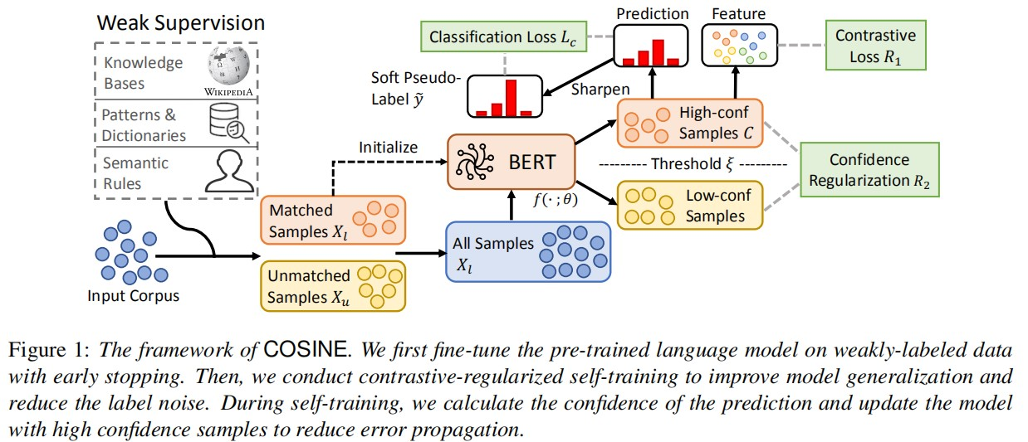
Method
Over view

Slide 5
Method
Initialization with Weakly-labeled Data.

Slide 6
Method
Contrastive Self-training with All Data.

Slide 7
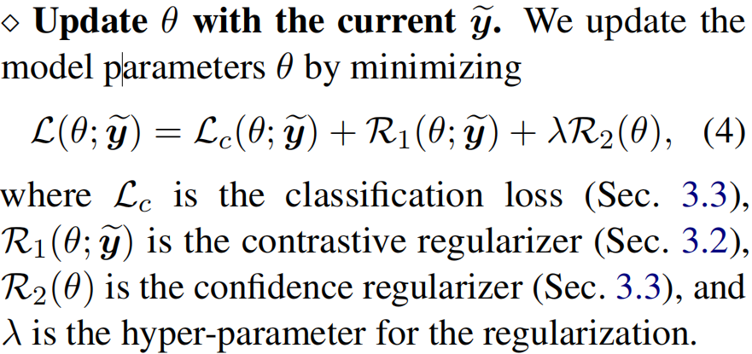
Method
Contrastive Self-training with All Data.

Slide 8
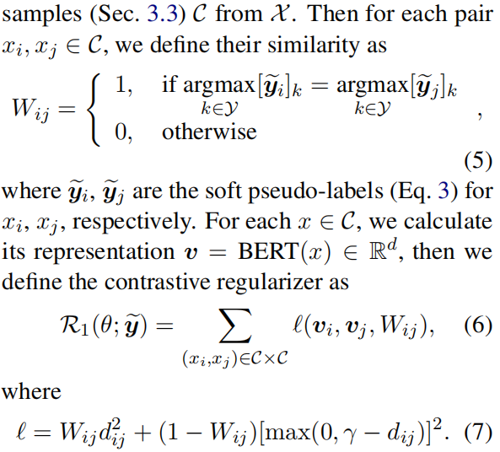
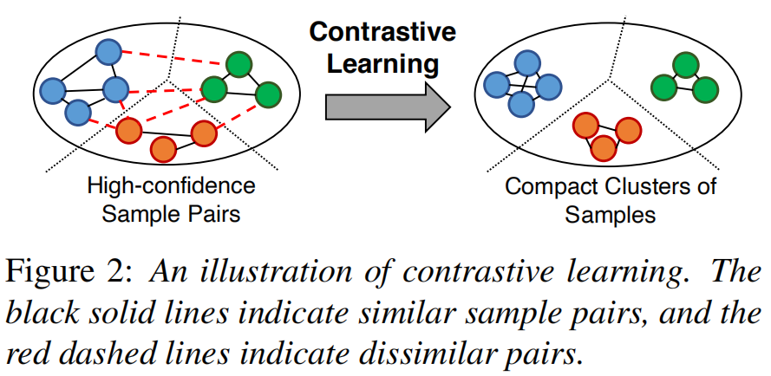
Method
Contrastive Learning on Sample Pairs

Slide 9
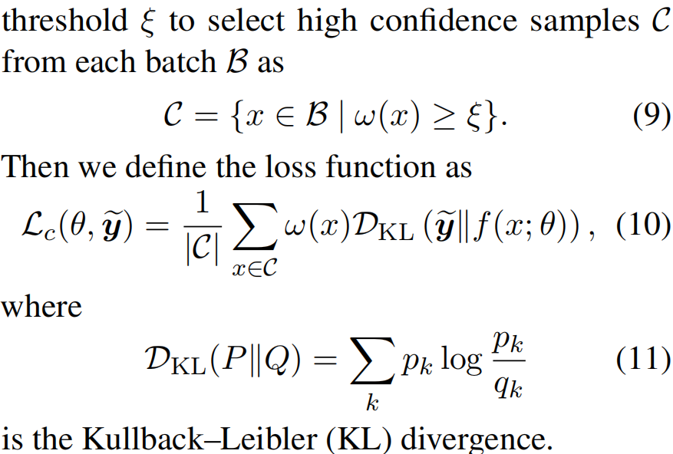
Method
Confidence-based Sample Reweighting and Regularization

Slide 10
Method
Confidence-based Sample Reweighting and Regularization

Slide 11
Experiment

Slide 12
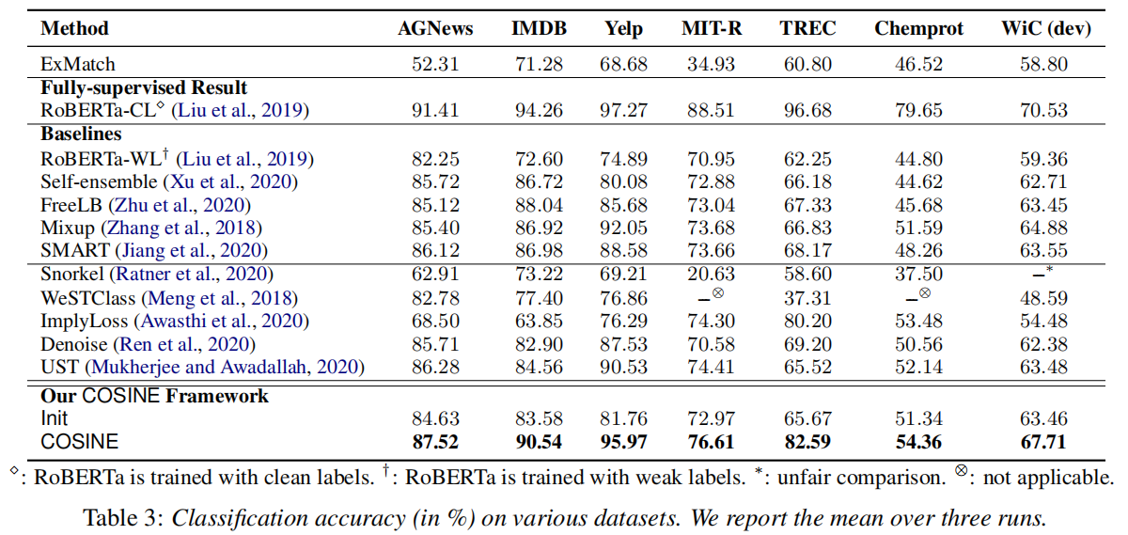
Experiment

Slide 13
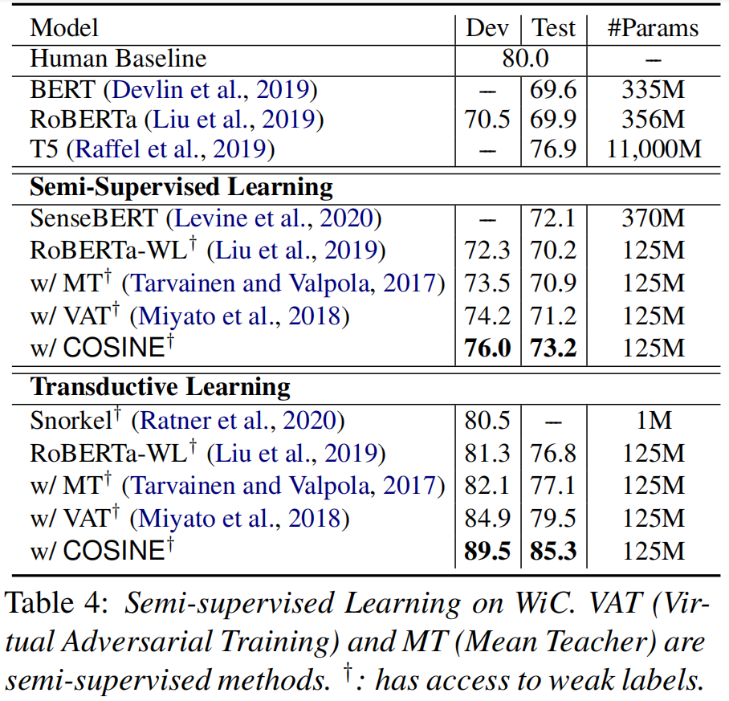
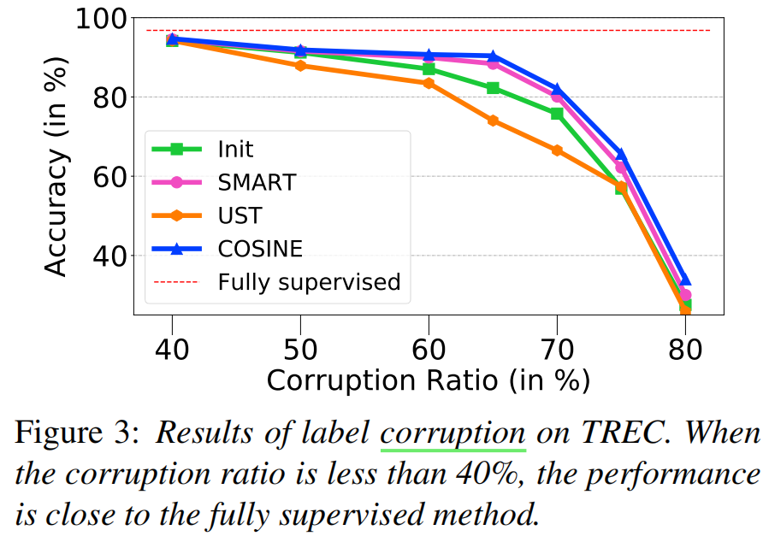
Experiment

Slide 14
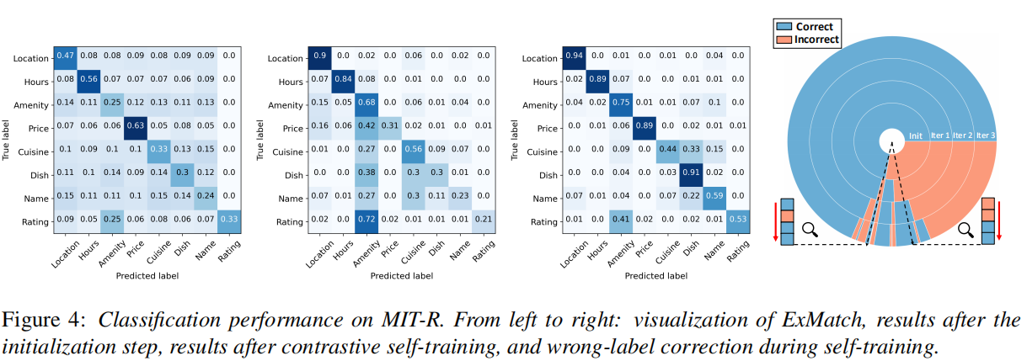
Experiment

Slide 15
Experiment

Slide 16
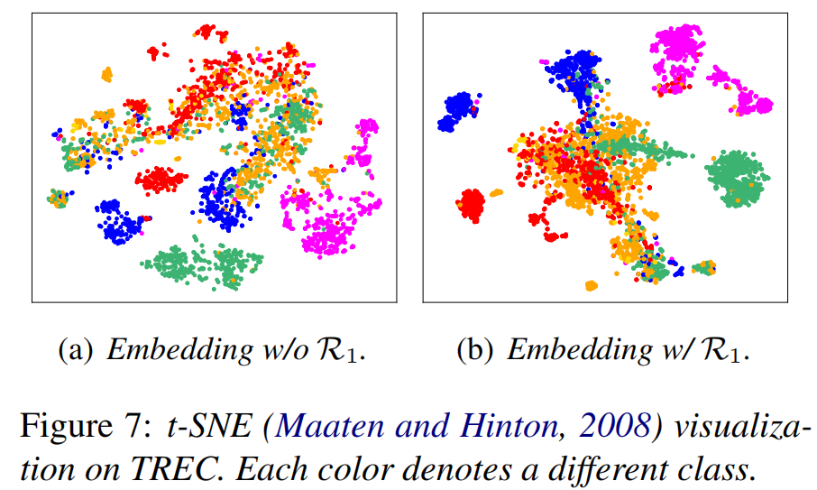
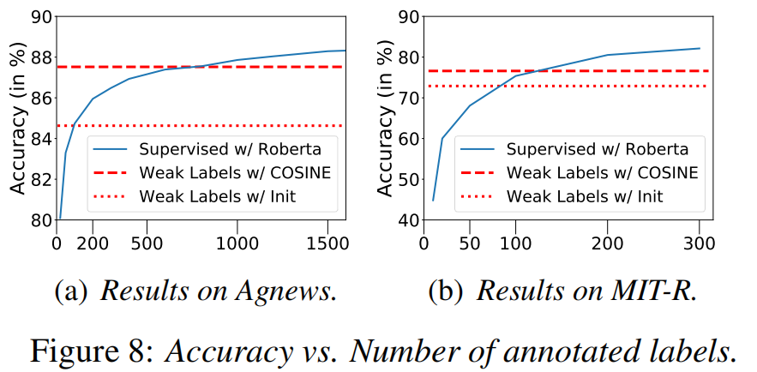
Experiment

Slide 17
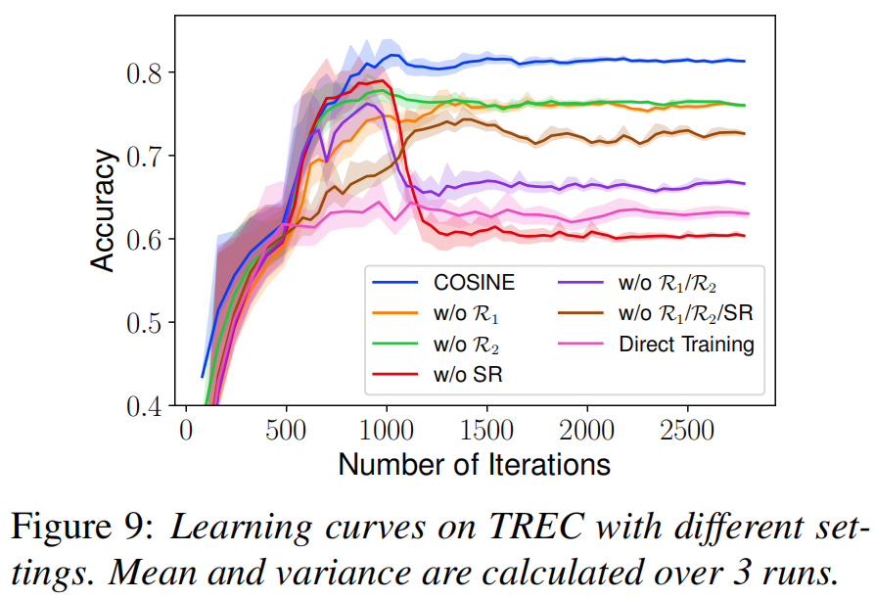
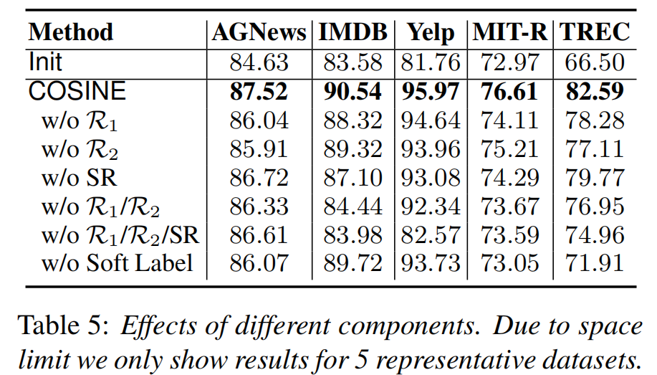
Experiment

Slide 18
Chongqing University of Technology
ATAI
Advanced Technique of Artificial Intelligence
Chongqing University of Technology
Thank you!

